Slide 1


Learn Its
at
Lacewood

Slide 2
What are Learn its?
‘Learn its’ is a teaching programme used to help children to become numerate. Problem solving and word problems cannot be solved until children can manipulate and understand how numbers work.
Learn Its are addition facts and times tables facts. There are 72 Learns Its in total. 36 addition Learn Its and 36 multiplication Learn Its. These are facts that children need to learn off by heart, so when they are asked ‘What is 6+4 ?’ they are able to give the answer as quickly as they would be able to tell you their name. As soon as they know 3x5=15 they also know 5x3=15 (This is known as a ‘Switcher’).

Slide 3
What happens in school?
As part of their everyday Numeracy lessons, Children will take part in fast-paced activities that are aimed to strengthen their number fact memory. These sessions are varied with a sense of fun and achievement at the core. Activities range from white board work, flashcards, ‘use what you know’ sheets, worksheets, songs and actions.
Big Maths Beat That
Every week the children sit a ‘Big Maths Beat That’ test. These tests are designed to be motivating, positive and of course fun. Every child in every class, sits whichever test is suitable to their level. This means that every child gains a sense of achievement as they work through their test trying to beat their own test score from the previous week.
Always try your best to be your best
Our school motto really supports the key elements of the learn its programme. Of course the aim is to get to know all of the learn its, but the effort along the way is what will make the difference. And it is this personal achievement that is rewarded in the classroom. The children are given mini certificates whenever they gain a new personal best score or when they are ready for their next ‘learn its’ challenge.

Slide 4
Helping your child at home
There is one very important rule when helping your child learn their ‘learn its’: NO FINGERS! Remember, these are supposed to be instant recall facts.
Counting
Practising counting in multiples is the first step to helping to consolidate number facts. Why not challenge your child to do this as they get dressed in the morning, before breakfast or whilst walking to school. Make sure your child can count in multiples not always from zero. For example counting in 4s from 32.
Learn Its
Allowing time for a learn its practise will really help in their ‘big maths beat that’ scores. There really is very little time to complete each of the tests. Don’t forget, children need to get full marks on a test three times before moving on to the next set of ‘learn its’.
Get involved!
In school, we have had reports of the whole family joining in. This not only makes it fun for the child but also spurs them on to do better than you!

Slide 5
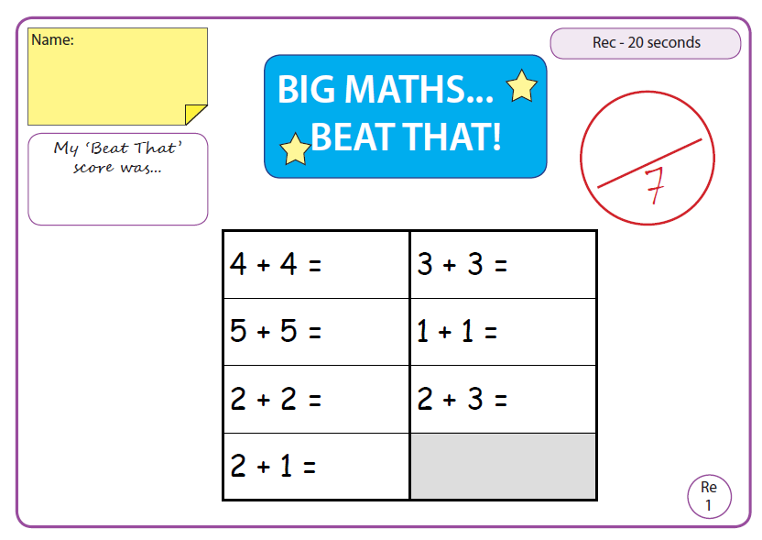
Example Big Maths Beat That Tests
Foundation Stage
The Foundation stage tests have seven number sentences to complete in 20 seconds.
Throughout the year, children will need to learn;
1+1 2+2 3+3 4+4 5+5 1+2 2+3
The class teacher will set the next set of learn its as and when your child is ready for it. Remember these must be instant facts – No fingers!

Slide 6
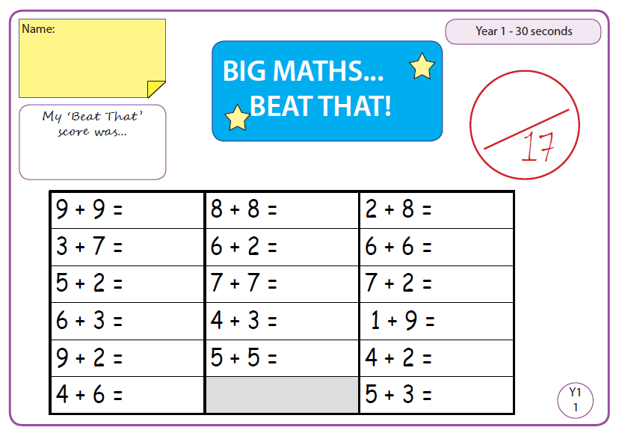
Example Big Maths Beat That Tests
Year 1
The year 1 tests have seventeen number sentences to complete in 30 seconds.
Throughout the year, children will need to learn;
2+8, 3+7, 4+6 , 4+2, 5+2, 6+2, 7+2, 9+2, 4+3, 5+3, 6+3 , 6+6, 7+7, 8+8, 9+9
The class teacher will set the next set of learn its as and when your child is ready for it. Remember these must be instant facts – No fingers!

Slide 7
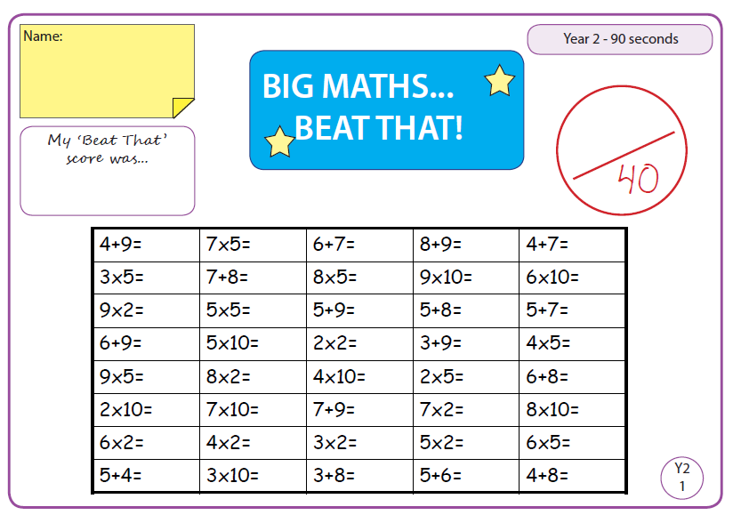
Example Big Maths Beat That Tests
Year 2
The year 2 tests have forty number sentences to complete in 90 seconds.
Throughout the year, children will need to learn;
3+8, 3+9, 4+7, 4+8, 4+9 , 4+5, 5+6, 6+7, 7+8, 8+9 , 5+9, 6+9, 7+9, 5+7, 5+8, 6+8 , x10, x5, x2
The class teacher will set the next set of learn its as and when your child is ready for it. Remember these must be instant facts – No fingers!

Slide 8
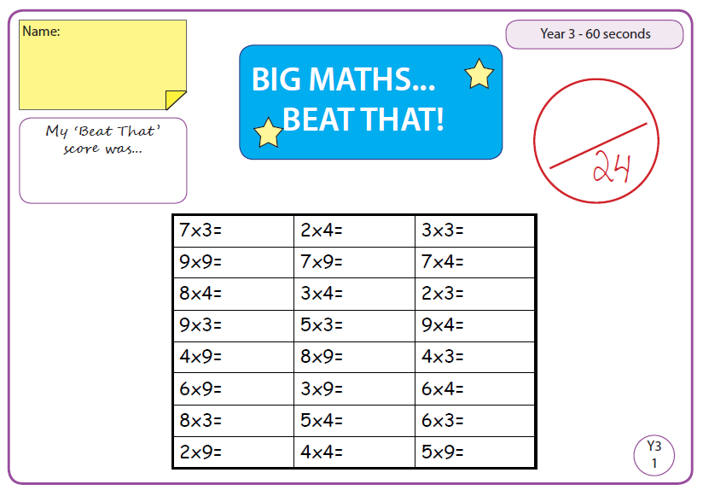
Example Big Maths Beat That Tests
Year 3
The year 3 tests have twenty four number sentences to complete in 60 seconds.
Throughout the year, children will need to learn;
x3, x4, x8
The class teacher will set the next set of learn its as and when your child is ready for it. Remember these must be instant facts – No fingers!

Slide 9
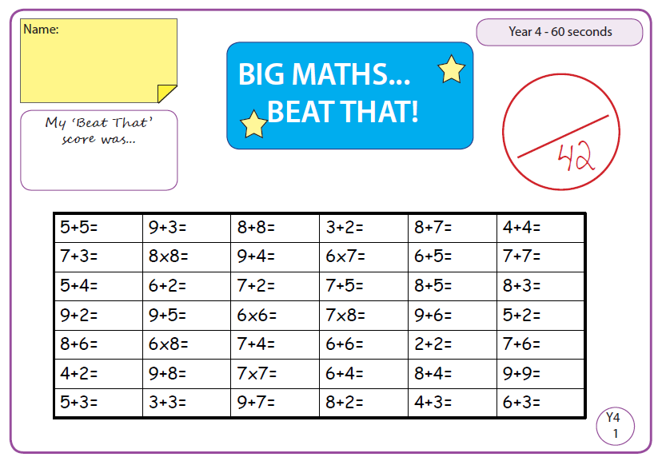
Example Big Maths Beat That Tests
Year 4
The year 4 tests have forty two number sentences to complete in 60 seconds.
Throughout the year, children will need to learn;
6x6, 6x7, 6x8, 7x7, 7x8, 8x8, x11, x12
The class teacher will set the next set of learn its as and when your child is ready for it. Remember these must be instant facts – No fingers!

Slide 10
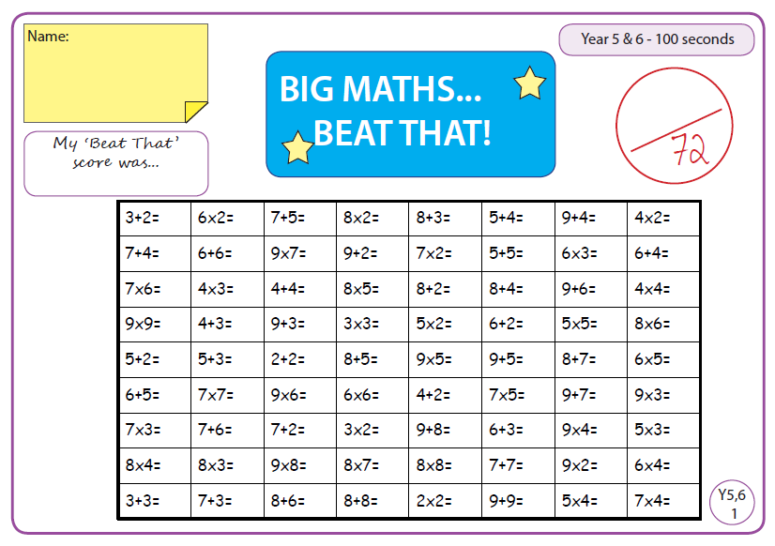
Example Big Maths Beat That Tests
Year 5 and 6
The year 5 & 6 tests have seventy two number sentences to complete in 100 seconds.
Throughout the year, children will practise all 72 learn its.
The class teacher, alongside the children, will set the learn its learn its to practise. Remember these must be instant facts – No fingers!

Slide 11
Programme Overview
 | Autumn Term | Spring Term | Summer Term
Foundation | 1+1 2+2 | 3+3 4+4 5+5 | 1+2 2+3
Year 1 | 2+8 3+7 4+6 | 4+2 7+2 5+3 5+2 9+2 6+3 6+2 4+3 | 6+6 9+9 7+7 8+8
Year 2 | 3+8 4+7 3+9 4+9 4+8 x10 | 4+5 7+8 5+6 8+9 6+7 x5 | 5+9 6+8 x2 6+9 5+7 7+9 5+8
Year 3 | x3 | x4 | x8
Year 4 | 6x6, 6x7, 6x8, 7x7, 7x8, 8x8 | x11 | x12
Year 5 and 6 | All previous ‘learn its’ | All previous ‘learn its’ | All previous ‘learn its’

