Slide 1
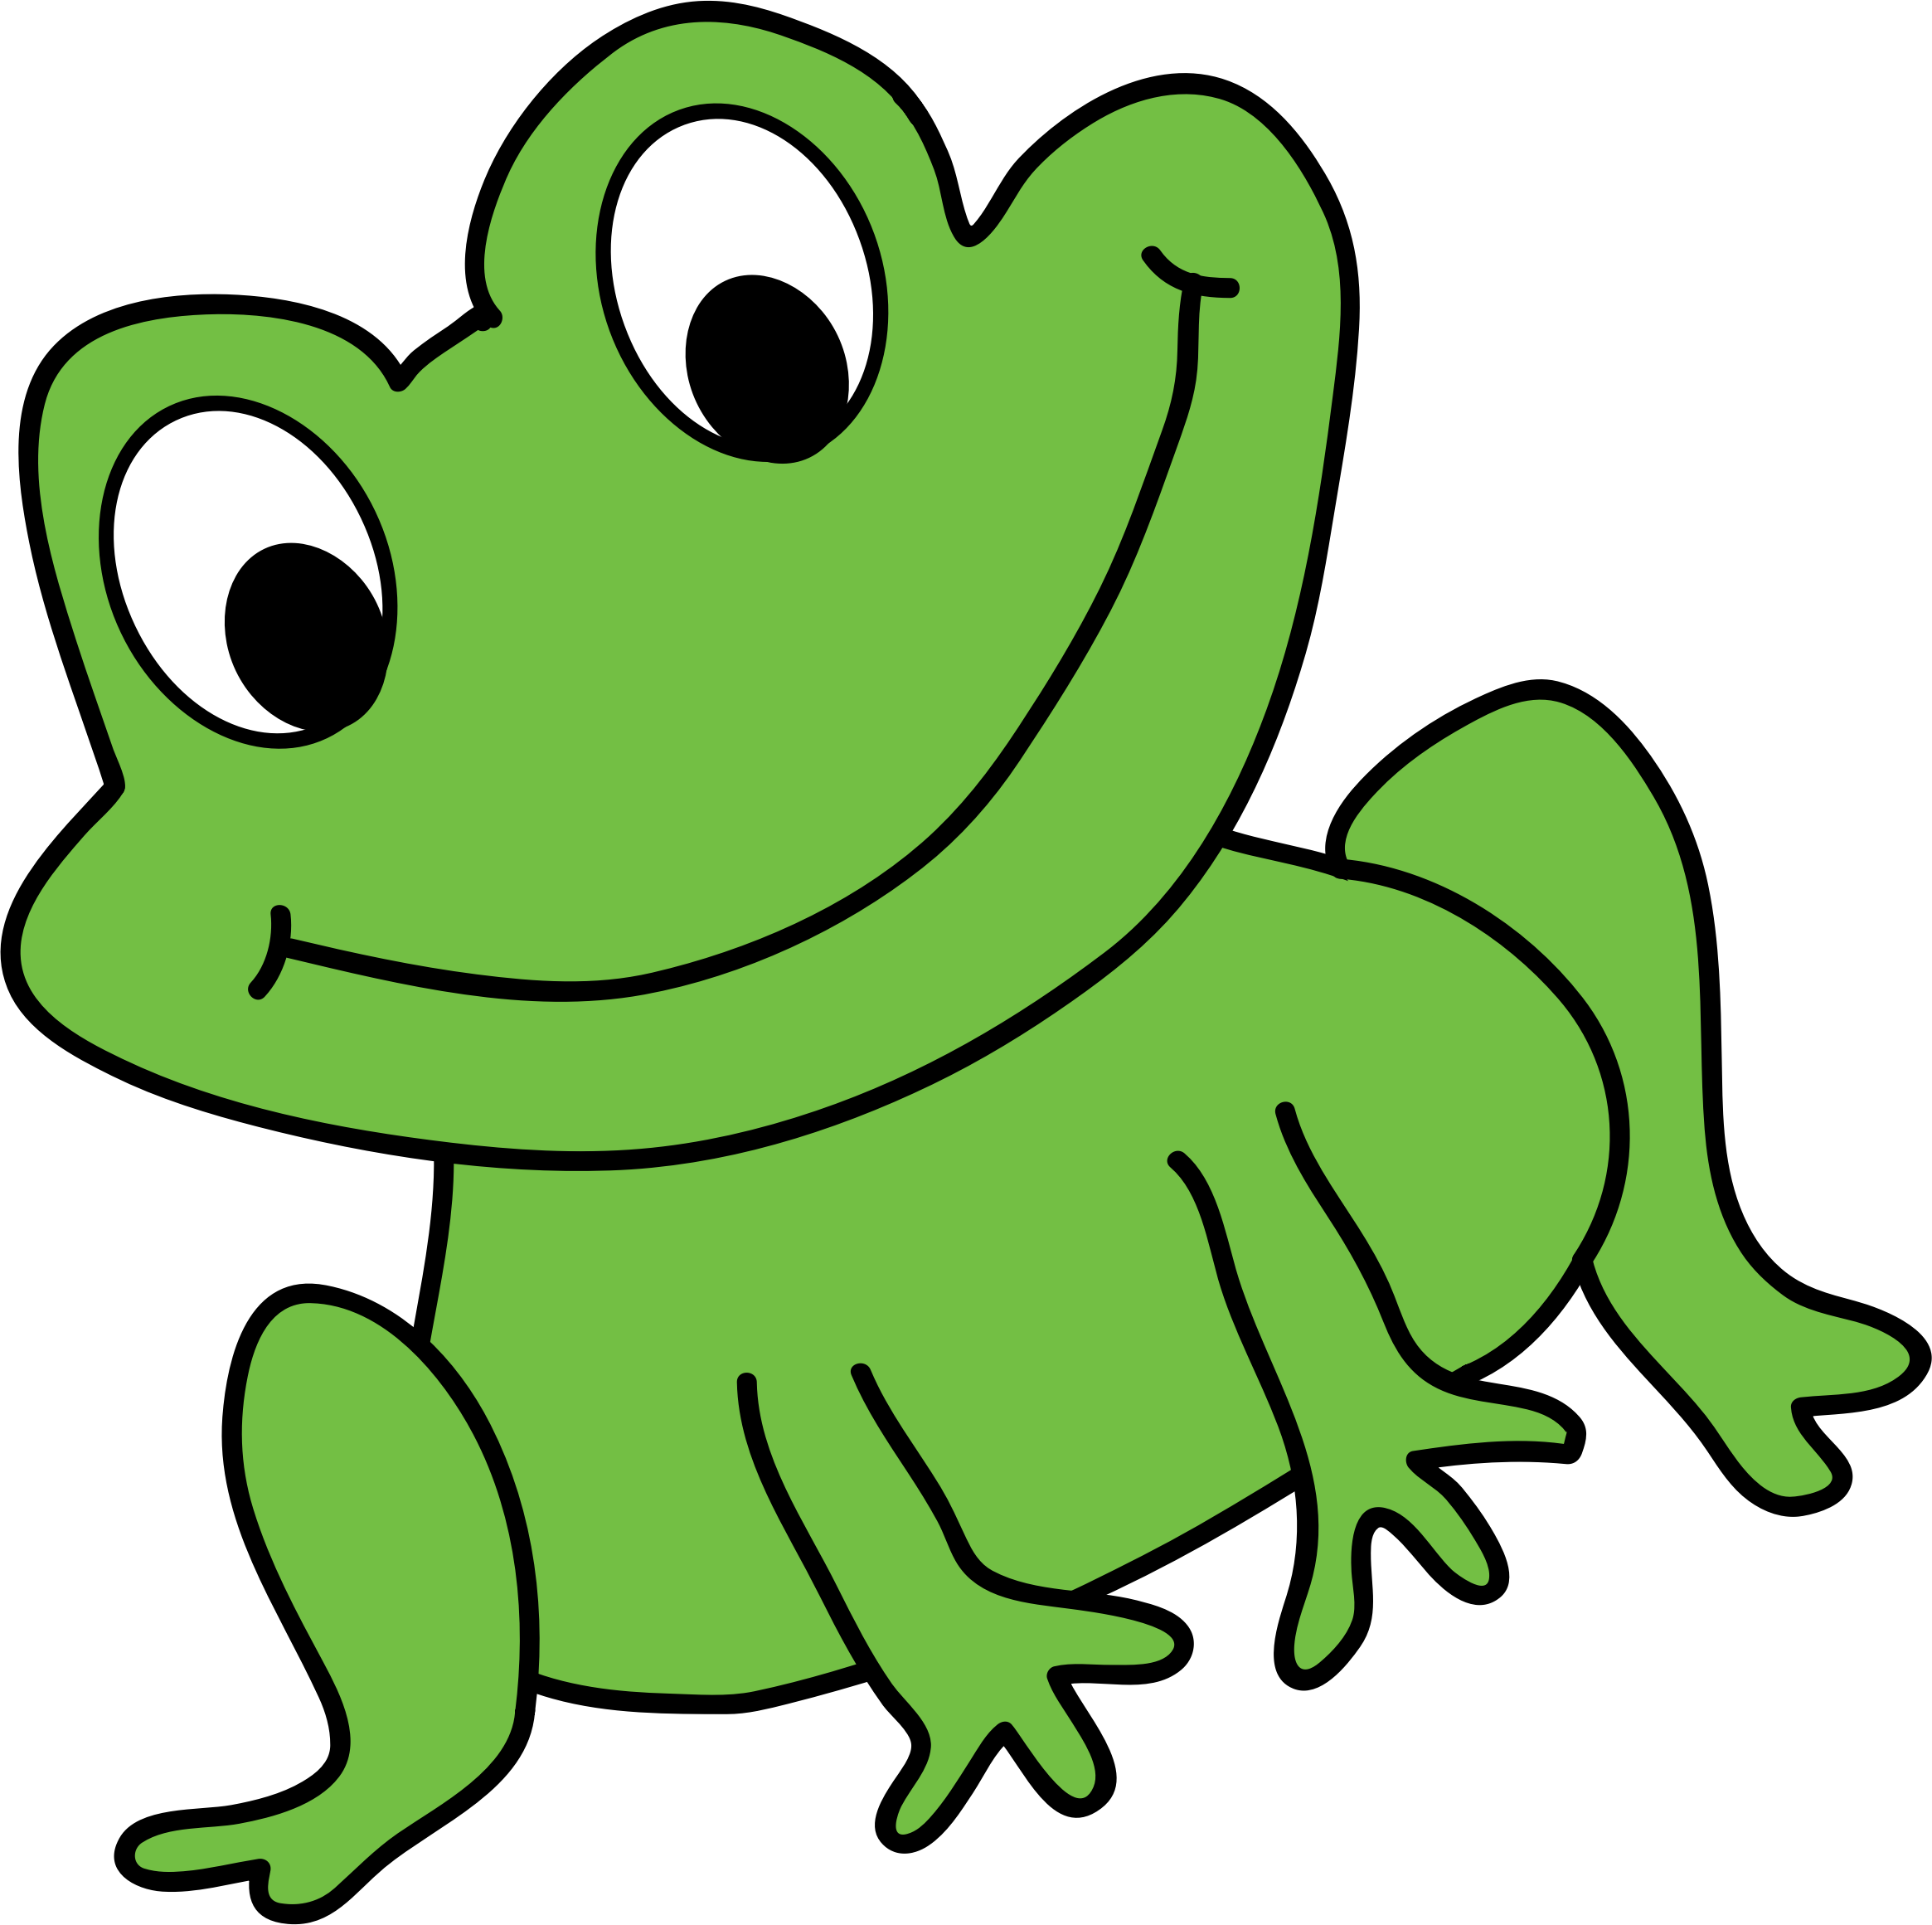
Meet the RWI characters
These characters help to introduce us to the sounds that we will learn in Read, Write, Inc. (Fred Phonics).
First we learn the picture and the word that matches it, by stretching or bouncing the sound at the beginning.
Once we know the character word, then we will learn the letter shape and its associated sound. We then practise, saying the word when we see the picture and the sound when we see the letter.

Slide 2
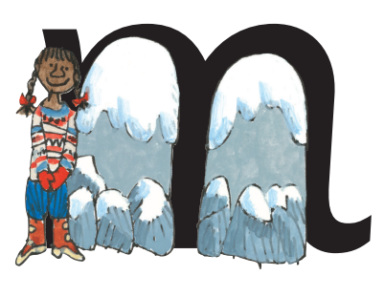

mountain

Slide 3

apple

Slide 4
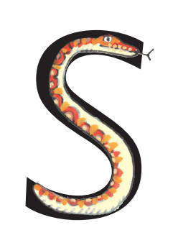
snake

Slide 5
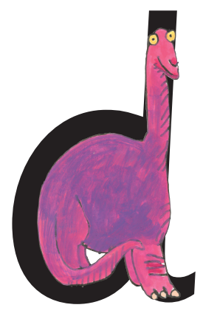
dinosaur

Slide 6
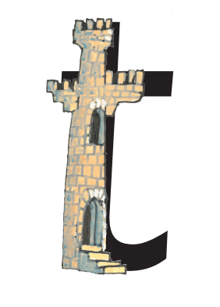
tower

Slide 7
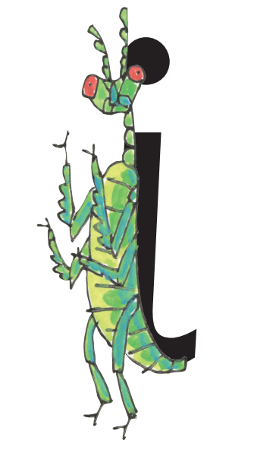
insect

Slide 8
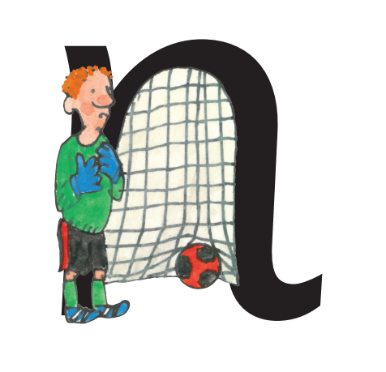
net

Slide 9
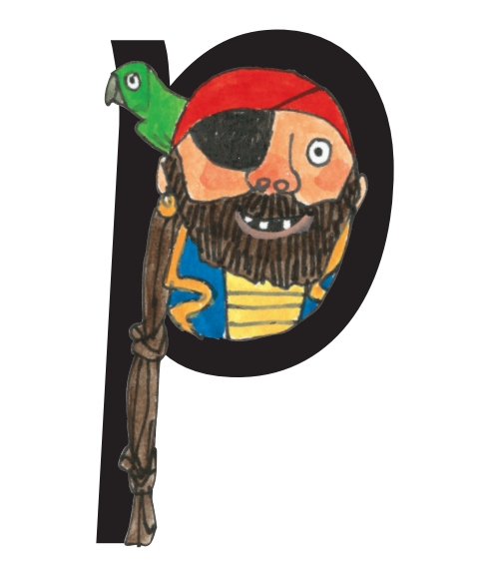
pirate

Slide 10
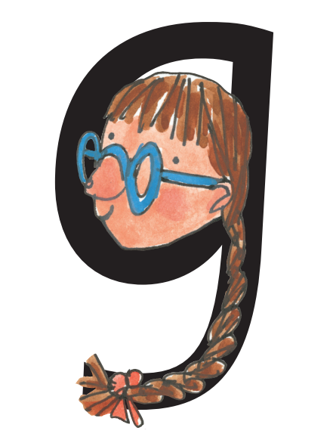
girl

Slide 11

orange

Slide 12

caterpillar

Slide 13

kangaroo

Slide 14
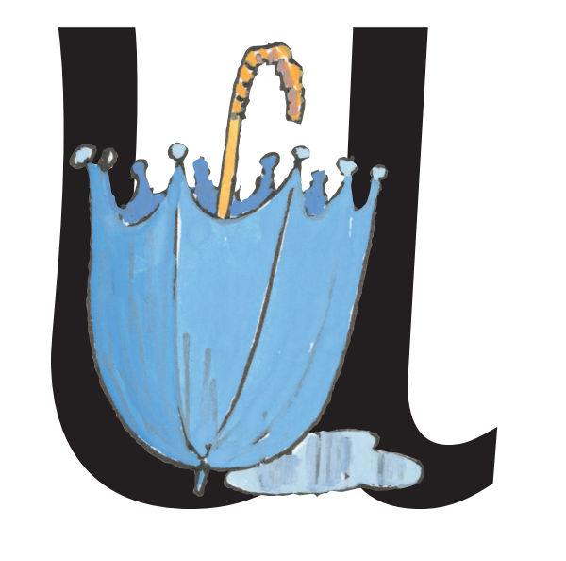
umbrella

Slide 15
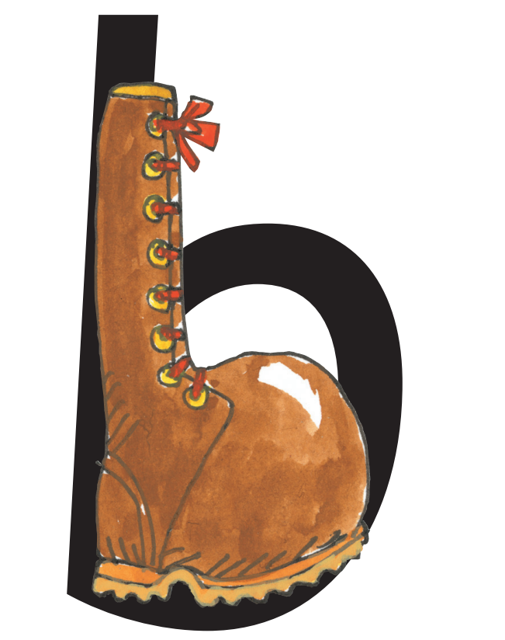
boot

Slide 16
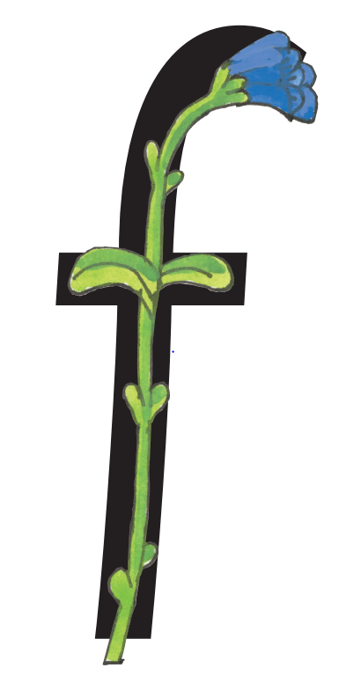
flower

Slide 17

egg

Slide 18
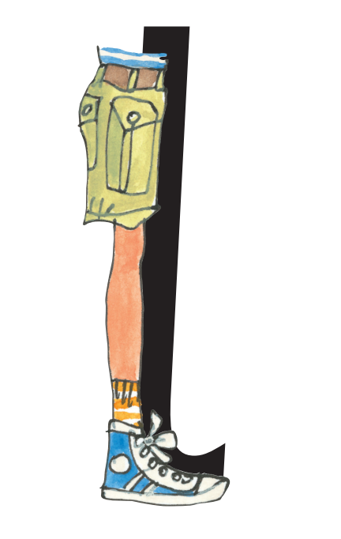
leg

Slide 19
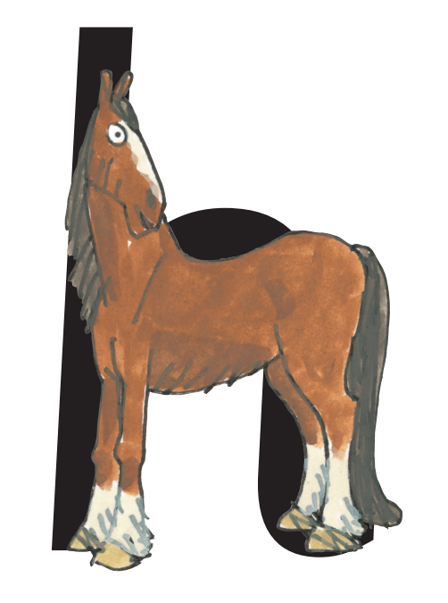
horse

Slide 20
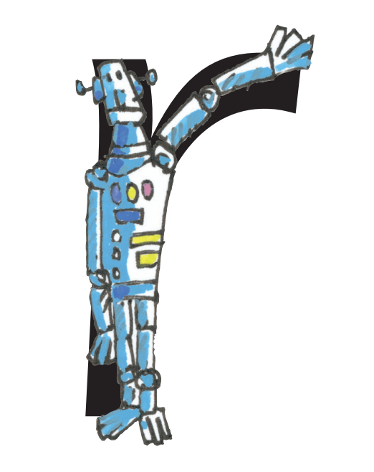
robot

Slide 21
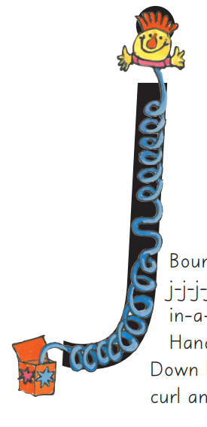
Jack-in-a-box

Slide 22

vulture

Slide 23
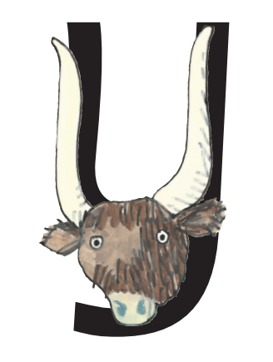
yak

Slide 24
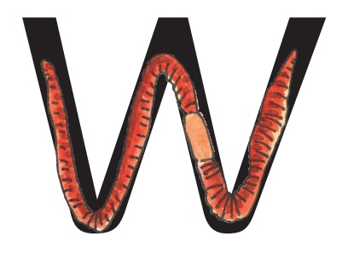
worm

Slide 25
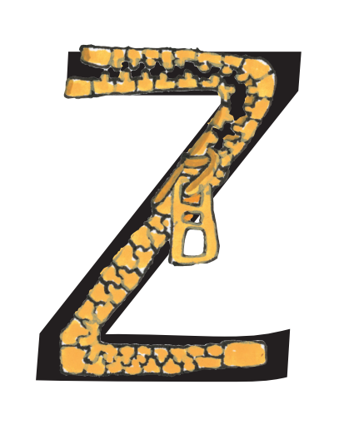
zip

Slide 26

eXercise

