Slide 1


Foundation Stage 2
Willow Class (Reception)
Information for New Starters 3

Slide 2
Reading books and Homework
To begin with children do not bring home a reading book until they have reached a particular level of the phonics programme.
Children choose a book once a week (occasionally once a fortnight) to share with their family and you will be given a reading journal to complete when you have shared the book.
The journal has questions and prompts on the back. Each term we change the level of questions.
Once their phonic skills have become established and they know some letters and sounds securely, we will start sending home reading books.
Initially these books are called “sound blending” books and include words that the children have been learning to read in their phonics lessons.
When the children reach the stage of the phonics programme where they read decodable story books, they will bring home a copy of the text they have read in class and a text that is matched to the shared class book. They will bring home a reading record book where you can add your own comments about their progress at home.

Slide 3
We listen to children read daily in our phonics lessons and aim to change their books once per week. Therefore, it is useful if they have their reading books inside their book bags everyday.
Book bags are provided for children once they start school.
Weekly homework is generally linked to the phonics skills the children will have covered in their phonic group that week. It is checked and changed every Friday but again, as we may collect any day from Wednesday, it is useful to leave their homework book inside their book bag each day.
We also sometimes hand out family homework projects. These are generally linked to an area of learning, current theme or area of interest to the children and include a range of activities to choose from. A period of up to 2 weeks is usually given to complete these family projects and a “hand in” date is provided on the homework task sheet.

Slide 4
Parental assessments and observations
For all children in Foundation Stage 1 and 2.
All children will be provided with a learning journey book for use at home to be completed by parents. This can be simple anecdotes of your child’s interests, trips and visits and anything else you think may be interesting to us e.g. comical comments, interesting questions they may ask etc.
When you want us to see the learning journey, please pass it to Mrs Broadhead on the door as you arrive.
If you are returning any letters, homework etc. Please also pass these to the adults on the door. We do not check in book bags everyday, so may miss them if they are left in there.

Slide 5
We are also asking for your opinion about where you feel your child is before they start in our setting.
You will receive a welcome pack with some questions about your child’s skills to help us complete our own baseline assessments of the children within the first 2 weeks of them starting FS2.
The questions will relate to the main points of our baseline assessment and you will have the opportunity to add some comments and observations of your child to support your thoughts.
We are not trying to catch you out and there is no right or wrong answer, so if you have any concerns about these sheets, please come and talk to us and we will do our best to support you.

Slide 6
Read, Write inc. (RWI)
This is the programme we use through school to teach phonics (letters and sounds). We start this programme at the beginning of FS2 (Reception Class).
To help us prepare the children for this programme, we have provided you with a sheet (in the packs) of the letters and sounds as taught in Rwi. You could visit the website listed at the top of the sheet to check on the correct pronunciation of each sound as we teach them to the children.
www.oxfordowl.co.uk – Oxford Owl for home/phonics made easy – how to say the sounds

Slide 7
At this point, we do not teach the children letter names or upper case lettering, it is all about the “pure sound” of each letter. You can start introducing your children to the letters and their sounds over the summer. Each letter also has a special phrase or rhyme to describe how we write them.

Slide 8
Behaviour strategies
The school has adopted the use of the Thrive Approach strategies to support and manage issues such as PSED, behaviour and spiritual well-being.
Essentially, Thrive involves a range of strategies to help children develop an awareness of their physical, emotional and problem solving responses to crisis, conflict and upset.
Children can receive a golden leaf award if they demonstrate positive, kind and helpful behaviour. Golden leaf winners receive a certificate and a special treat at the end of each half term.

Slide 9
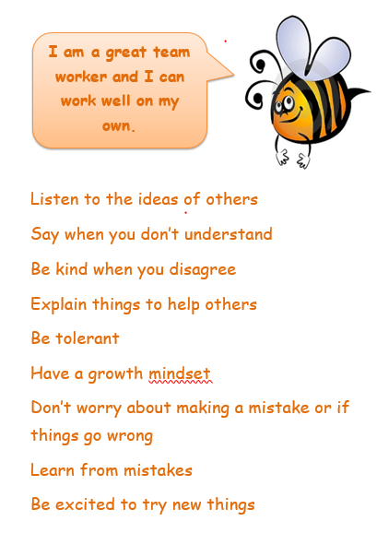
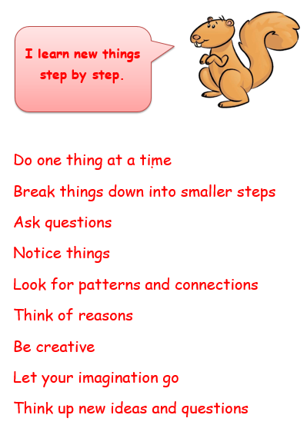
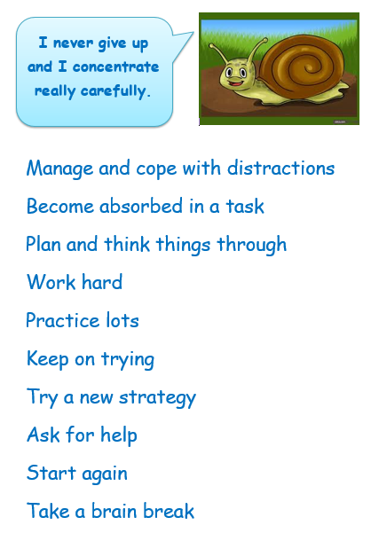
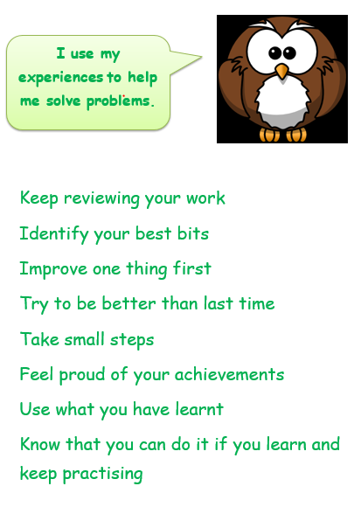
Learning Buddies
The school learning buddies help us to understand and develop a whole range of learning characteristics. We use them to help us learn, promote our self-esteem and as a reward for our efforts throughout school.

Slide 10
Playing and exploring – engagement
Finding out and exploring
Playing with what they know
Being willing to ‘have a go’
Active learning – motivation
Being involved and concentrating
Keeping trying
Enjoying achieving what they set out to do
Creating and thinking critically – thinking
Having their own ideas
Making links
Choosing ways to do things

Slide 11
Each week we choose a merit award winner for a pupil who has demonstrated a particular learning behaviour or attitude towards their learning that matches to one of our learning buddies. The merit winner receives a certificate in our Friday merit celebration assembly and parents/families are invited to attend.
We also hand out other rewards and recognition of positive learning characteristics in the form of stickers and postcards home – these recognise the positive attitude of pupils to overcome difficulties and to apply their learning skills in different ways.
The end of year report will provide information about your child’s characteristics of early learning.

