Slide 1

Foundation Stage 2
Willow Class (Reception)
Information for New Starters 1

Slide 2
Background to our setting
Our Foundation Stage comprises of a FS1 (nursery) class and a FS2 (reception) class sharing one setting.
FS1 is called Cherry Class.
FS2 is called Willow Class.
The classes split for registration, whole class and adult led activities and going home routines.
During the middle of each session, the 2 classes combine to share the provision. Adults support children and extend their learning during their independently chosen activities.

Slide 3
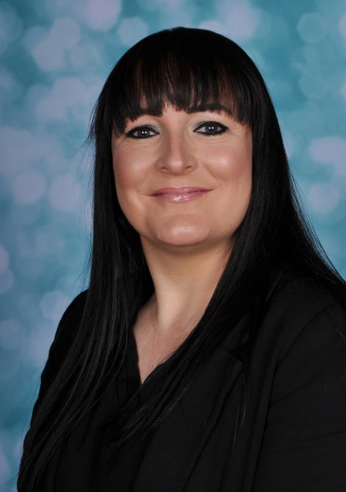
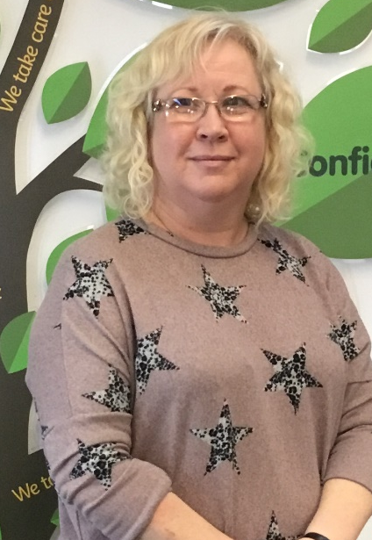
The staff – Willow Class
Lynsey Andrews
FS2 class teacher, Assistant Head Teacher, Reading Leader, Early Years Foundation Stage Lead.
Rachel Broadhead
Teaching assistant based mainly in FS2. NNEB nursery nurse.

Slide 4
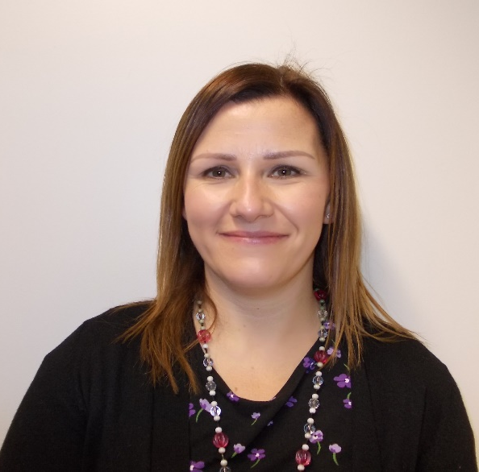
The staff – Willow Class
Nichola Skirrow
FS2 class teacher (Pm),

Slide 5
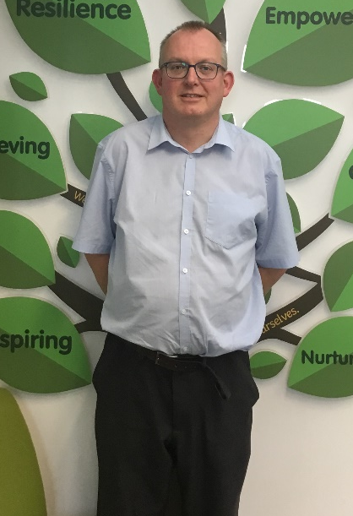
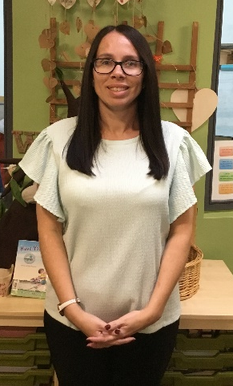
The staff – Cherry Class
Andrew Kettle
FS1 class teacher.
Shelley Hollingworth
Teaching assistant based mainly in FS1.

Slide 6
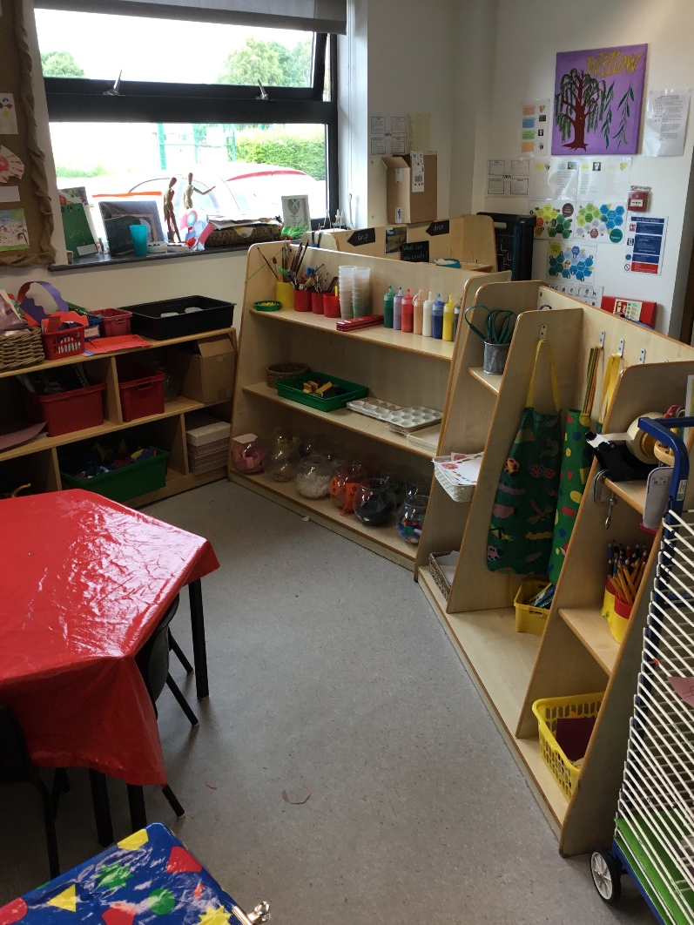
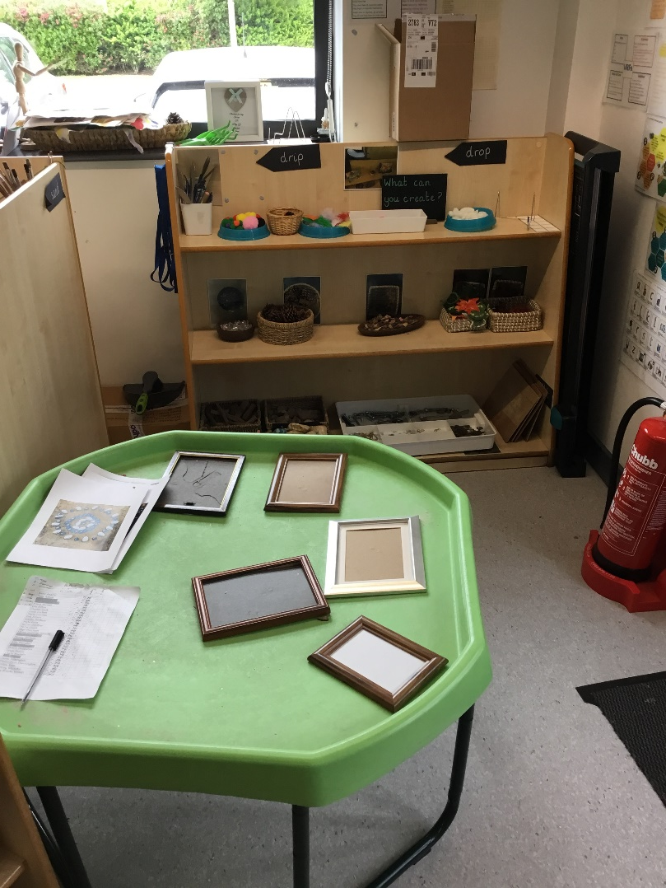
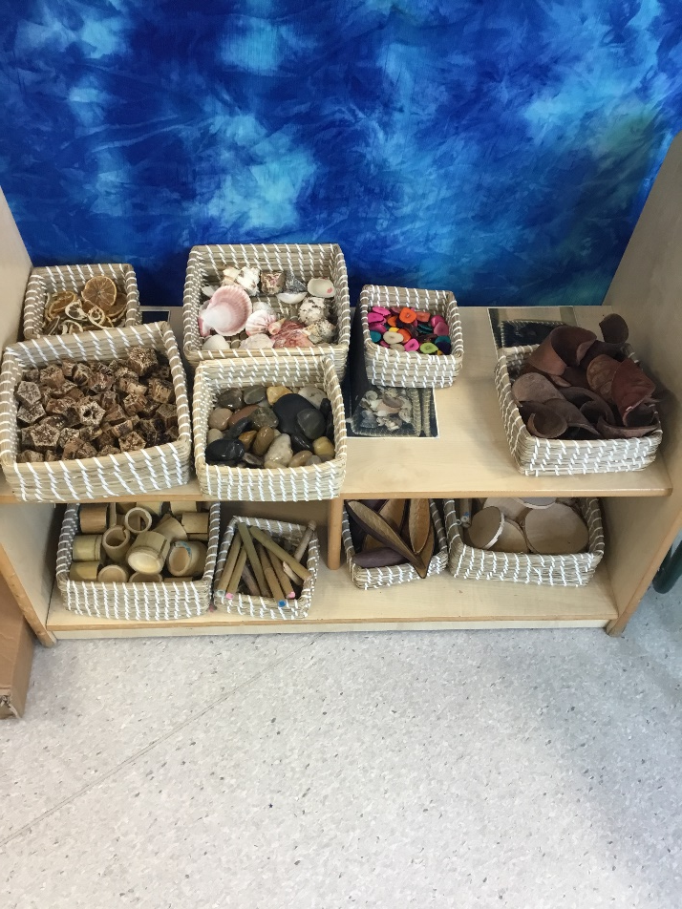
Take a look at our setting

Slide 7
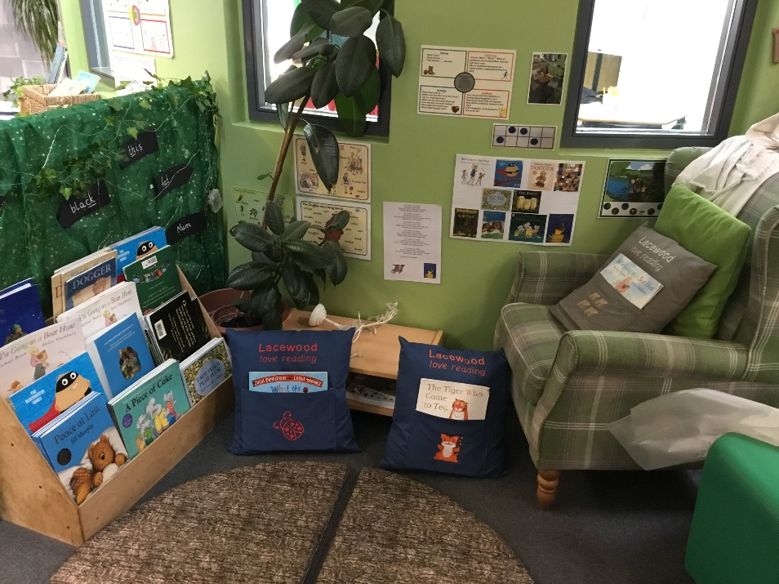
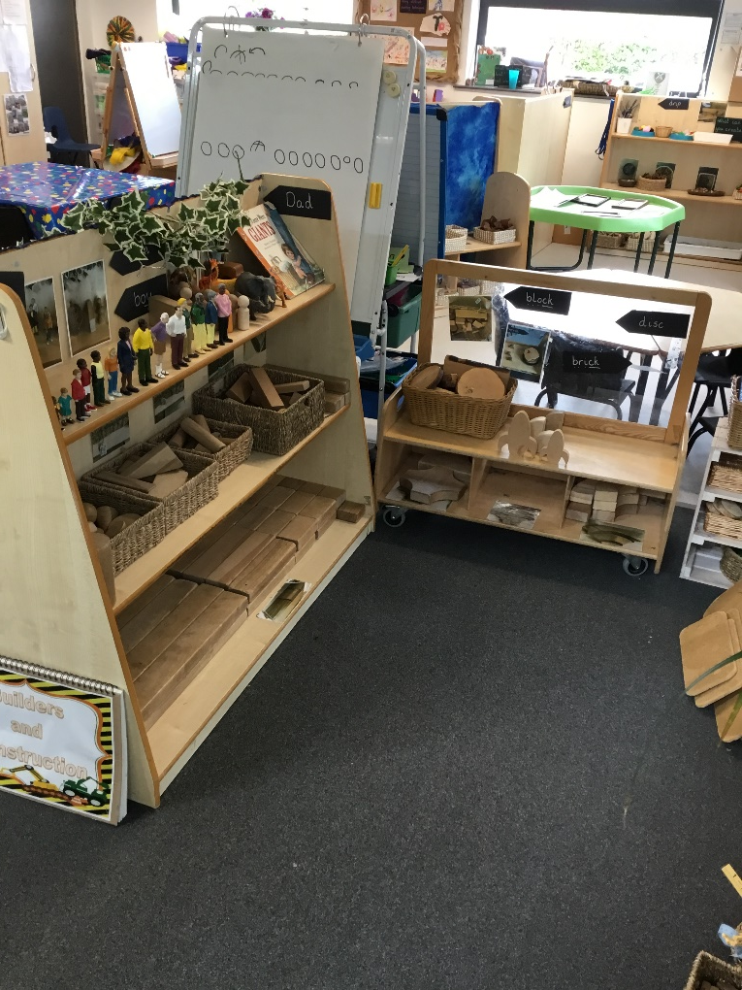
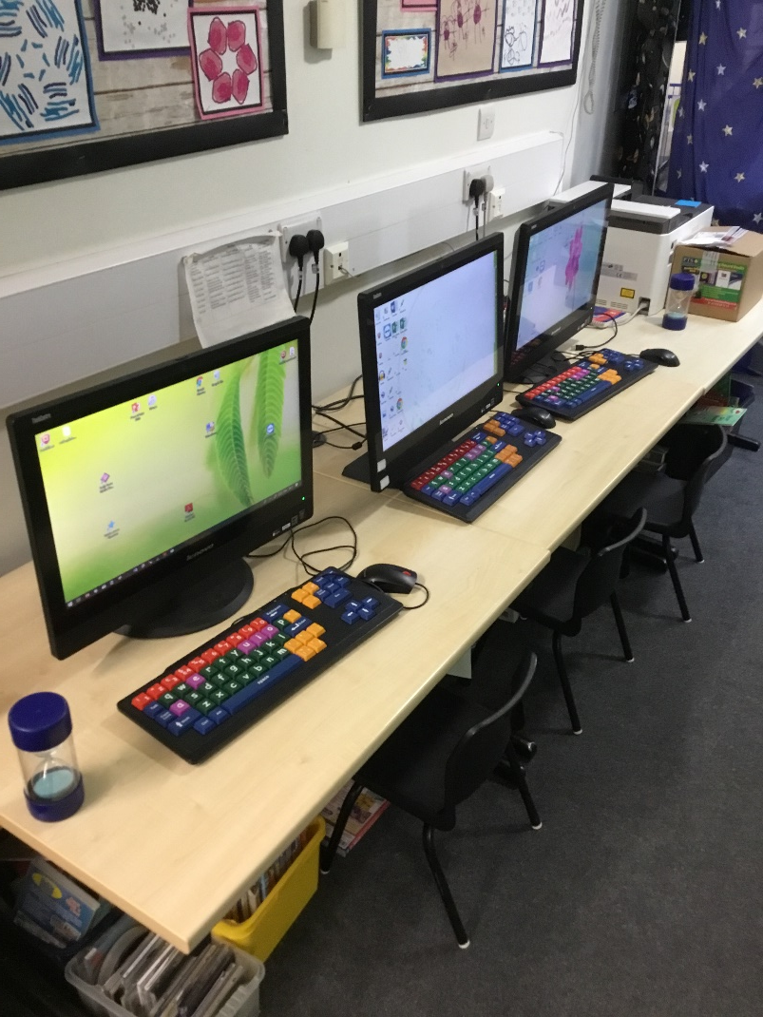

Slide 8
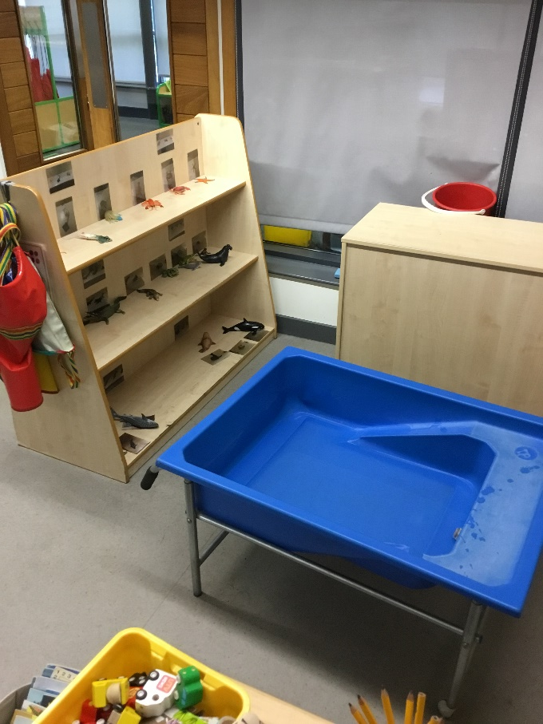
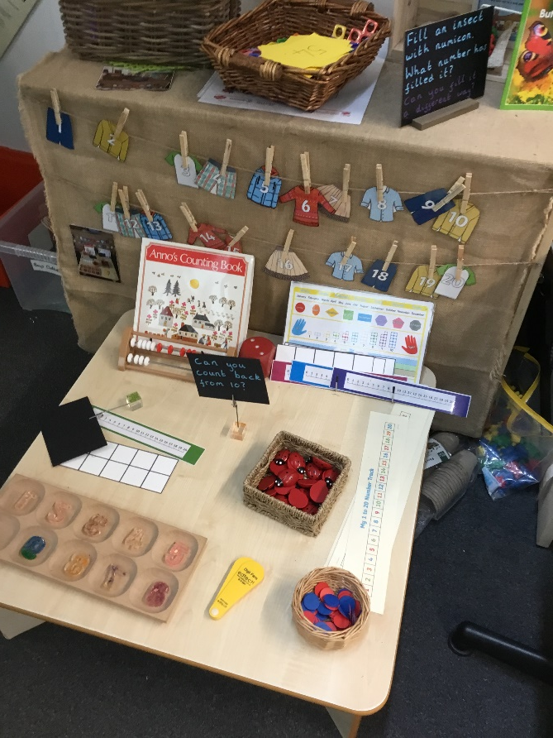
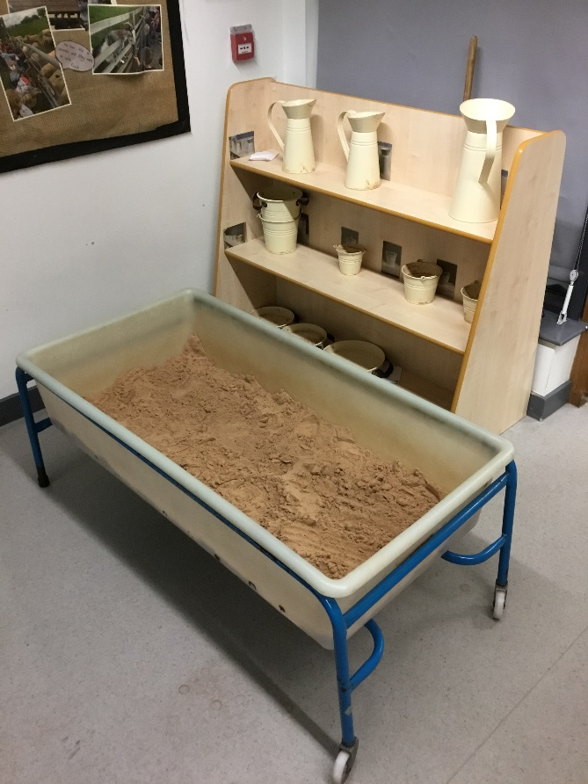
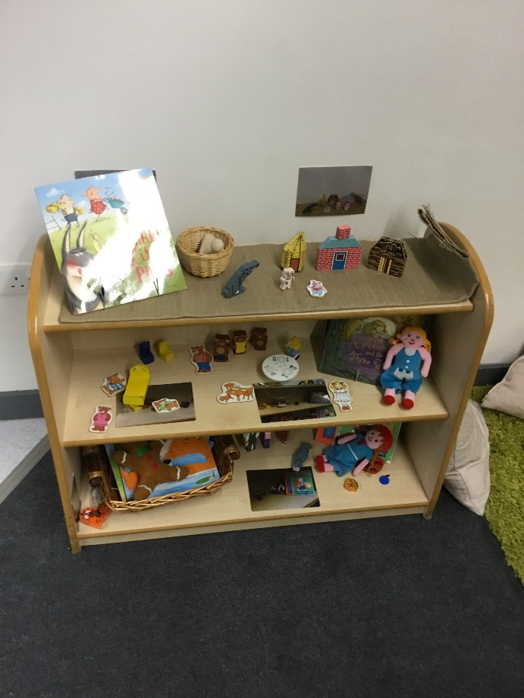

Slide 9
Clothing/Uniform
Children in Willow Class have to wear full school uniform daily.
We like to think of the outside area as part of our classroom and aim to utilise it as such everyday. Please ensure your child has suitable clothing to play indoors and outdoors every day.
We have some outdoor puddle suits/waterproof coats for outdoor messy play and/or to suit wet and wintry weather conditions.
Please be prepared for children to occasionally come home a little messy – a sign of a busy and productive day.
We ask every child to bring a pair of wellies to leave at school to wear for outdoor play. We suggest a size bigger than they need, so that they last longer. We do have some spare wellies. Please write the child’s name inside.

Slide 10
Slippers for indoor use. Not essential but recommended so they always have something comfortable to change into. The children each have a drawstring bag that is kept on their peg that they can be kept in.
Please, please write your child’s name in everything!
We have a no jewellery policy in school and a child cannot take part in PE lessons, after school clubs and climb on the climbing frames if they have earrings in. The very nature of our provision is to keep the children physically active, and considering we access the outdoor environment throughout the session, jewellery is not conducive to any of our early years practise.
If your child is prone to needing clothing changes, please ensure they have spare clothing every day as we do get through our spare clothing quite quickly.

Slide 11
Key Workers
Every child in Foundation Stage will be assigned a key worker.
The key worker for Willow Class children will be either Mrs Andrews/Mrs Skirrow or Mrs Broadhead.
We all take responsibility for observing and assessing every child but a key worker will get to know the children in their group a little more and will liaise with parents about their likes and interests and any other important information.

Slide 12
School timetable
The doors to the cloakroom will open at 8.35am along with the rest of school.
School begins at 8.45am this is when the register is taken.
Children arriving late (once the doors have been closed) need to enter via the main entrance so that they can receive their mark.
School closes at 3.15pm. Children with older siblings in KS2 please collect the younger children first.

Slide 13
FS2 children will enter Foundation Stage from the cloakroom by themselves and Mrs Broadhead will be on the door to answer any questions or pass on messages to the teachers who will be in class helping the children to settle.
If you need to speak to the class teacher, Mrs Broadhead will arrange to make an appointment for you.
Please take any items that need to be seen by the teacher from book bags and pass them to the child or Mrs Broadhead to pass on. We don’t check every book bag every day.
When picking your child up Willow Class will use the exit in the classroom, rather than the cloakroom. Mrs Skirrow will usually be at the door to let children out.

