Slide 1

Welcome to Holly class
2024/25 – Miss Dawson

Slide 2
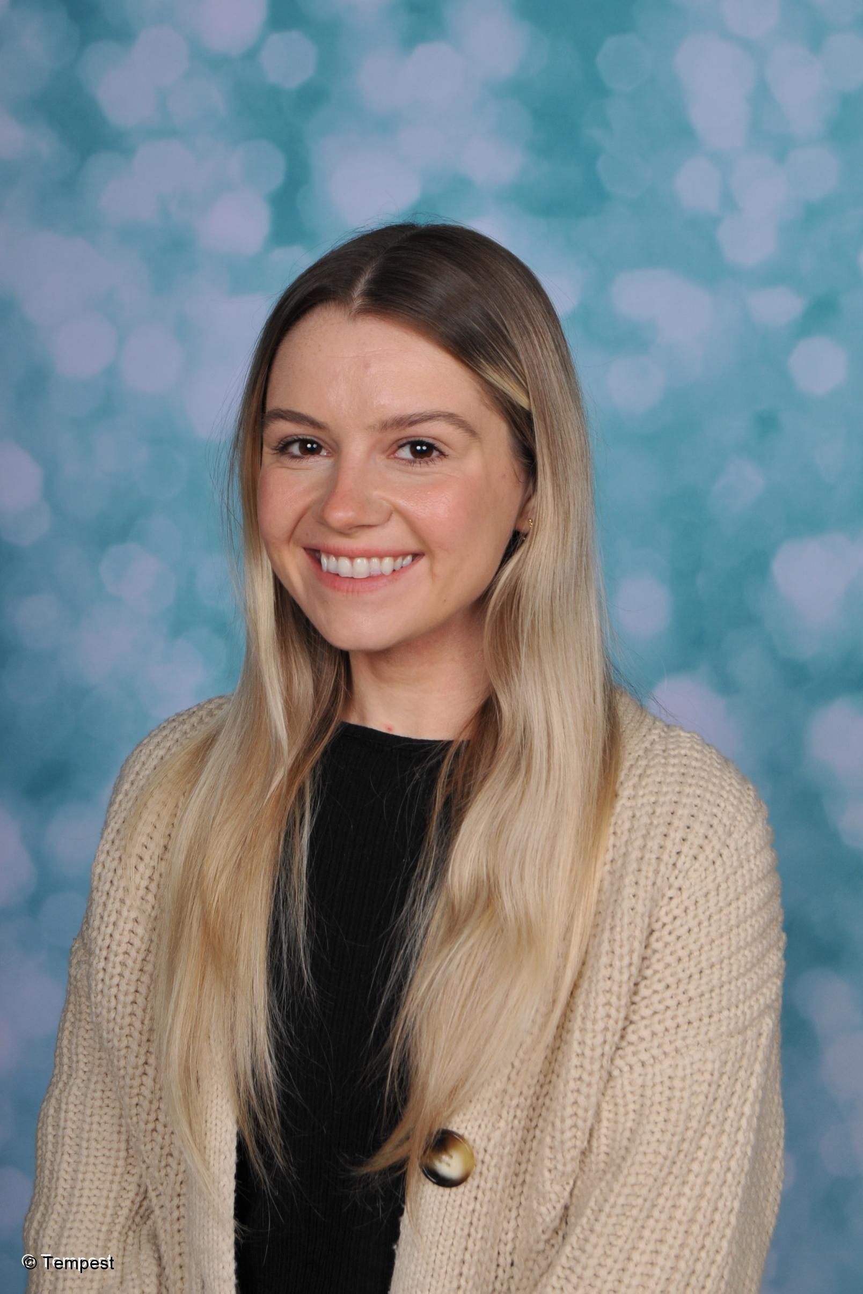
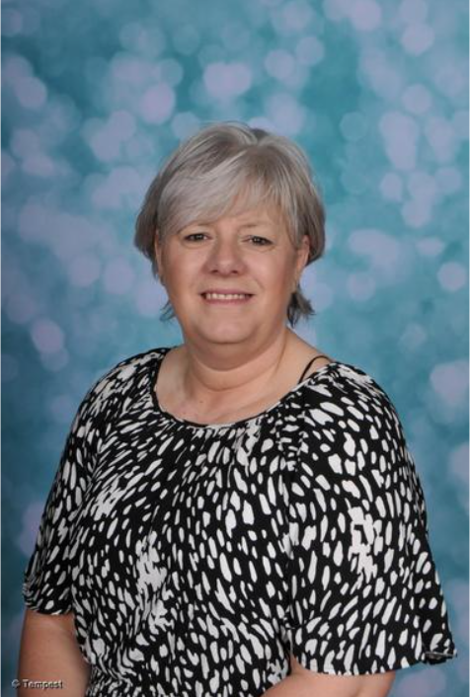
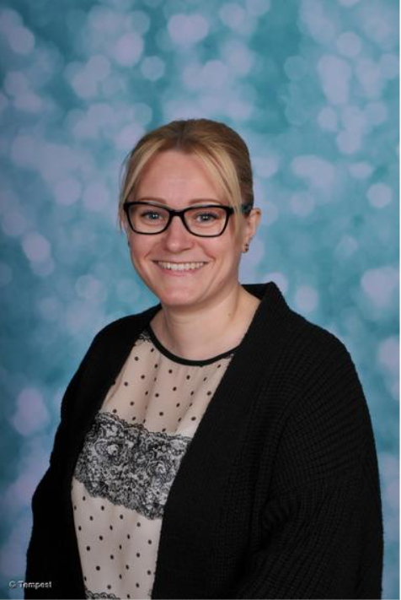
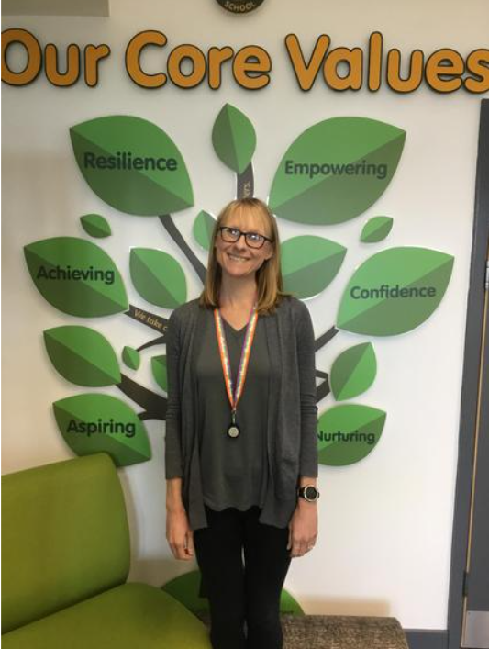
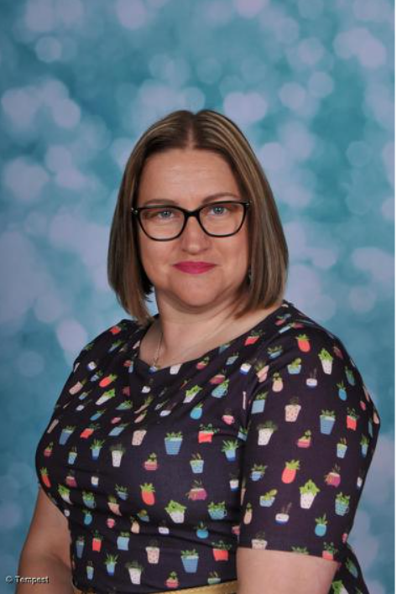
Year 3 staff
Miss Dawson – Teacher
Mrs Hughes – Teaching Assistant
Mrs Jones – Teaching Assistant (mornings)
Mrs Milburn – Teaching Assistant (afternoons)
Mrs Hughes – PSHE (Thursday afternoons)
Mrs Greaves – RE (Thursday afternoons)

Slide 3
Themes
Autumn 1 & 2 – Stone Age – Iron Age (History focus)
Spring 1 – Water world (Geography focus)
Spring 2 – Egyptians (History focus)
Summer 1 – The Lake District (Geography focus)
Summer 2 – Passage to India (Geography focus)

Slide 4

PE – Monday & Friday
Children will have 2 PE sessions per week.
In Spring 2 – Summer term term Holly class will be taking part in swimming lessons (Dearne). Letters will be sent regarding this and the day this will be taking place closer to the date. This will then count as one of their PE sessions.
Children must bring their Lacewood PE shirt and plain black shorts, leggings or tracksuit bottoms for PE. They will also need trainers and a plain hoodie/ jumper in case PE is outdoors. Children will not be able to participate if they do not have full PE kits.
I would advise children to keep their PE kit at school during the week and take it home to be washed over the weekend as needed.

Slide 5
Things to remember
Children should come in full school uniform every day.
Jewellery – Children should not be wearing any jewellery in school at all, only a watch (no smart watches). Children who have their ears pierced should not be wearing earrings for school and cannot join in PE wearing earrings.
Children should bring their book bag and reading book to school every day.
Children should bring a water bottle to school everyday.
Please make sure children are at school on time (8:35 – 8:45am)

Slide 6


Daily mile/ skipping/ mini workout
As a school we also take part in quick blasts of exercise, these are great to help keep the children focused on their learning. This will often take place to break up double lessons in a morning or afternoon.

Slide 7
Our school’s golden rules
We take care of ourselves.
We take care of each other.
We take care of the things around us.

Slide 8
Classroom Expectations
We always tell the truth.
We help each other.
We are kind to one another.
We look at the person who is speaking.
We listen carefully when others are speaking.
We are always polite and use manners.
We put our hand up when waiting to speak and do not shout out.
We always try our best to be our best.

Slide 9

Dojo
We will be using ClassDojo to log behaviour and keep in contact with parents.

Slide 10

Cpoms
Behaviour incidents are also logged on Cpoms, this is so school can keep a record of anything that has happened in school. Home issues and SEN meetings can also be logged here.

Slide 11

Children will be expected to practise their spellings, complete a maths homework task and read their book as part of their weekly homework in Year 3.
Spellings will be handed out on Mondays and spelling tests will take place on Fridays. Children will have ten words to learn to spell and these will usually follow a spelling pattern. To help the children with learning their spellings they will also complete daily spelling activities using this week’s spelling words during morning task each day in class. Children will be given their spelling books back on Fridays to return to their drawer (and check their score).
MyMaths – weekly maths homework

Slide 12
Reading – Children can bring their reading book home daily or just over the weekends, however their reading book must be at school everyday for class reading time. The children will have their book changed as and when they complete the book after they have been listened to reading with an adult in class. Reading books at home as much as possible is also so beneficial for children's reading development. Children can read any books at home, it does not have to just be their school book! Parents can log reading in the reading record sheets in the childrens reading folders.
Times tables – children will have a different times table to focus on learning each half term (4 times tables) we will work on these in class but children should also spend time practising these at home. Children will be tested on these weekly in a timed test and will be rewarded if they beat their previous week’s score.
Children will also receive a variety of homework projects to choose from each half term before starting a new theme!

Slide 13
School trips
We already have some exciting trips booked for this year’s Holly class.
These are related to their learning themes and will help with their learning journey. These will be able to be paid for via Arbor.
September 25th – Stone Age experience day (Murton Park) Full day.
Stone Age – Iron Age topic
November 13th – Stone Age workshop (Experience Barnsley) Full day.
Stone Age – Iron Age topic
February 12th – Yorkshire Water workshop (Ewden reservoir) Morning.
Water world topic

Slide 14

Nessy
All children in Y3 will be screened for Nessy.

Slide 15
Weekly Merits
Merit assemblies will continue to take place on Fridays at 2:45pm. Parents are welcome to attend to see their child receive a merit.

Slide 16
Thank you!
We’re all looking forward to a new year with a new Y3 class!
Thank you in advance for working with us to support your child’s learning journey.

Slide 17
Questions & concerns
Staff are always here to help and support in any way we can.
Any worries or concerns can be sent through Dojo or the class Facebook page as a private message to the class teacher or can be discussed by contacting the school office on: 01709 887750.

