Slide 1


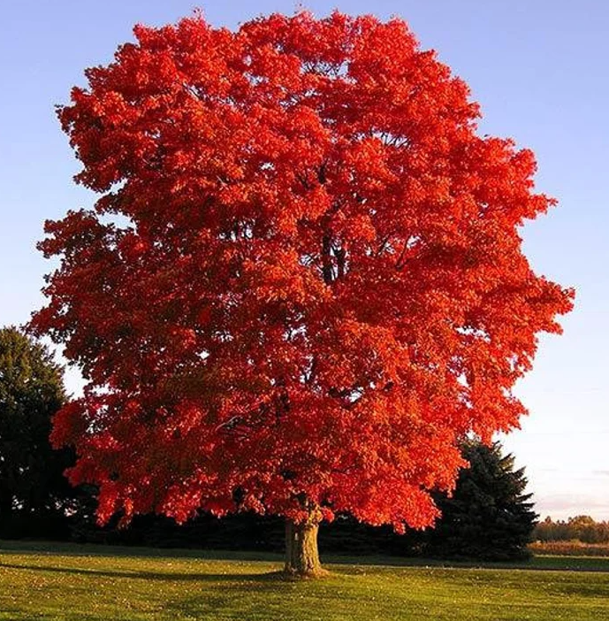
Y2 Maple Class Autumn 2 Overview
Hello parents and carers, this half term your child will be learning about…
In our core subjects, we are learning about…
Subject | Focus
English | During our literacy lessons this half term we will be creating our own: Story ( based on the book – The Queen’s Hat) Non- Chronological Report ( all about habitats) Recount/Diary (Trip to RSPB Old Moor)
Maths | During our numeracy lessons this half term we will cover: Addition and Subtraction Shape
Science | Living Thing and their Habitats(biology)
In our foundation subjects, we are learning about…
Subject | Focus
History | Magnificent Monarchs (of the UK, in particular Queen Victoria, King Edward VIII and Queen Elizabeth II)
Science | Habitats (including microhabitats)
DT | Structures – Baby Bear’s Chair
PE | Invasion games & Gymnastics
Computing | IT skills - Word
RE | Special Books: Christianity & Judaism (Bible & Torah)
Music | Orchestral Music
PSHE | Relationships

Slide 2
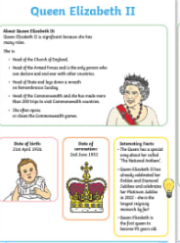
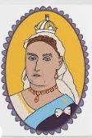
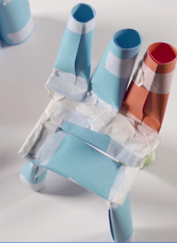
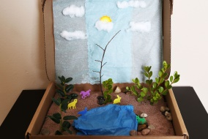
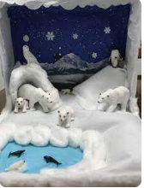
Y2 Maple Class Autumn 2 Homework
Hello parents and carers, this half term your child will be learning about…
Subject | Focus
History | Magnificent Monarchs (of the UK, in particular Queen Victoria, King Edward VIII and Queen Elizabeth II)
Science | Habitats (including microhabitats)
DT | Structures – Baby Bear’s Chair
PE | Invasion games & Gymnastics
Computing | IT skills - Word
RE | Special Books: Christianity & Judaism (Bible & Torah)
Music | Orchestral Music
PSHE | Relationships
History
Research one of our key monarchs, create a fact file, poster or even a painting.
Homework Ideas
Science
Make a model of a habitat and explain how certain animals are suited to it
DT
Try to build a structure of your own. Test out materials first for stability.

