Slide 1


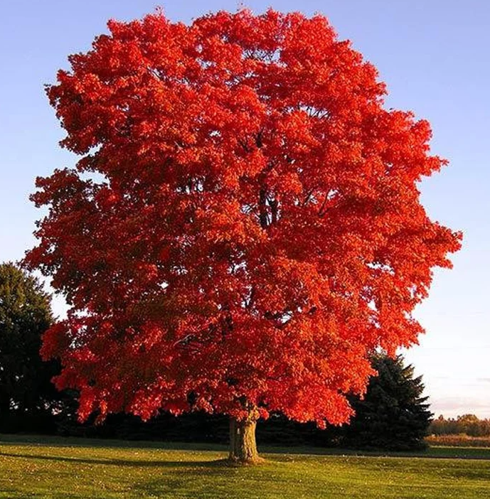
Y2 Maple Class Spring 1 Overview
Hello parents and carers, this half term your child will be learning about…
In our core subjects, we are learning about…
Subject | Focus
English | During our literacy lessons this half term we will be creating our own: Story (about The Great Fire of London) Newspaper Report ( linked with our learning on The great Fire of London)
Maths | During our numeracy lessons this half term we will cover: Shape Money Multiplications & Division
Science | Everyday Materials (physics)
In our foundation subjects, we are learning about…
Subject | Focus
History | London’s Burning- The Great Fire of London
Art | Paul Klee- London Landmarks ( the art of printing)
PE | Sending and Receiving (Thursday) & Dance (Friday)
Computing | Computer Science - Beebots
RE | What can be learnt from significant people of faith? Focussing on Christianity and Judaism
Music | Orchestral Instruments– Kapow!
PSHE | Relationships

Slide 2
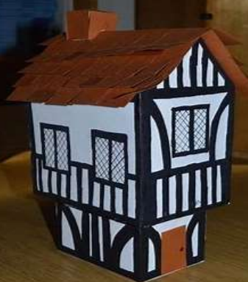
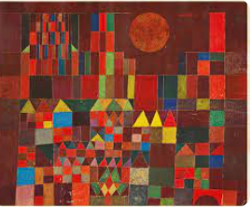

Y2 Maple Class Spring 1 Homework
Here are a few helpful ideas for the half termly homework project. These are only here as a suggestion, please feel free to get creative and do something that’s not already mentioned!
History- London’s Burning!
Design and make a Tudor house.
Make Thomas Farriner’s bakery where the fire actually started in 1666.
Homework Ideas
Science
Research different materials.
Design your ‘dream house.’
Label the materials you would need to build it.
Art
Take inspiration from our artist Paul Klee and create a block printing. Create repeating patterns

