Slide 1


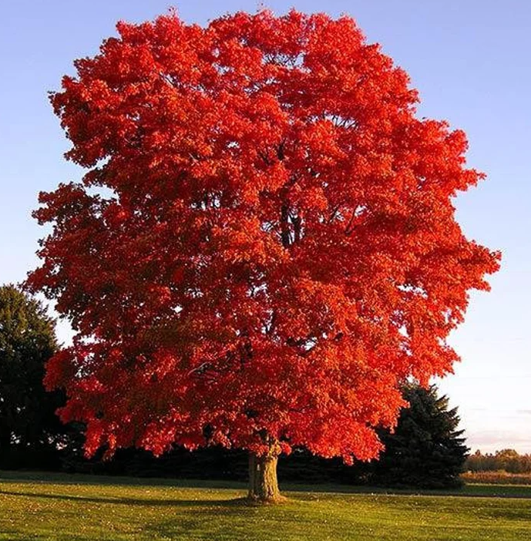
Y2 Maple Class Summer 1 Overview
Hello parents and carers, this half term your child will be learning about…
In our core subjects, we are learning about…
Subject | Focus
English | During our literacy lessons this half term we will be creating our own: Setting description- down the pit Recount- linked to our trip to the national coal mining museum
Maths | During our numeracy lessons this half term we will cover: Length & height Mass, capacity & temperature Fractions
Science | Plants
In our foundation subjects, we are learning about…
Subject | Focus
History | Going Underground (coal mining)
Art | Alexander Calder –The Art of Sculpture
PE | Athletics/Net & Wall
Computing | Computer Science – Lightbot
RE | What places are special?
Music | On this Island- British Song & Sounds (Kapow!)
PSHE | Physical Health and Wellbeing

Slide 2
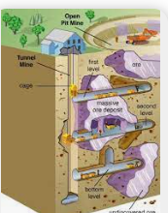
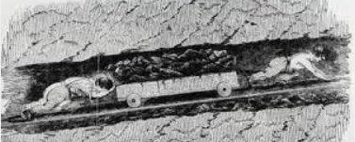
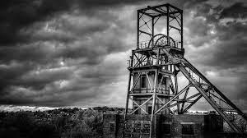
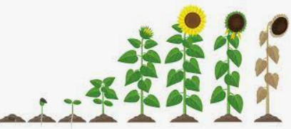
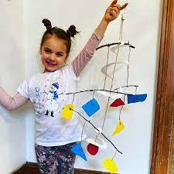
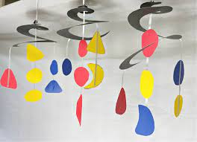
Y2 Maple Class Summer 1 Homework
Here are a few helpful ideas for the half termly homework project. These are only here as a suggestion, please feel free to get creative and do something that’s not already mentioned!
History- Going Underground!
Design or make a pit head
Shoebox deign of down the mine
Diary of a miner
Science
Plant your own seeds and document their growth.
Make a presentation all about plants
Homework Ideas
Art
Take inspiration from our artist Alexander Calder and make a mobile sculpture!

