Slide 1


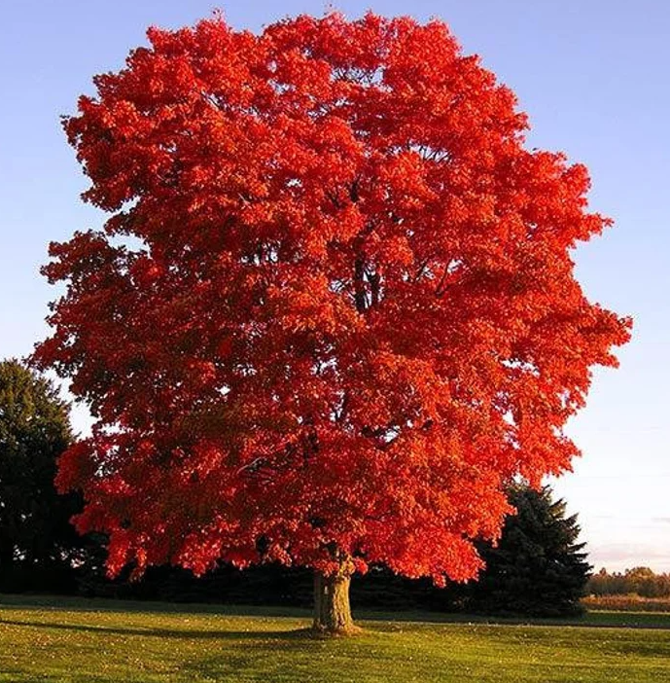
Y2 Maple Class Summer 2 Overview
Hello parents and carers, this half term your child will be learning about…
In our core subjects, we are learning about…
Subject | Focus
English | During our literacy lessons this half term we will be creating our own: Instructions – based on plants Adventure story - based on the story Traction Man!
Maths | During our numeracy lessons this half term we will cover: Fractions Time Statistics Position & Direction
Science | Plants
In our foundation subjects, we are learning about…
Subject | Focus
Geography | Farm to Fork ( comparing farming within the UK with farming in Egypt)
DT | A Balanced Diet – Making a healthy wrap!
PE | Striking & Fielding and Team Building
Computing | 2 Animate
RE | How do I and other feel about the universe around us?
Music | Myths & Legends
PSHE & RSHE | Growing & Changing

Slide 2
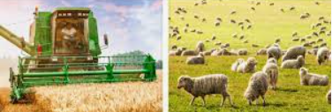
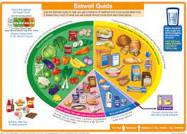
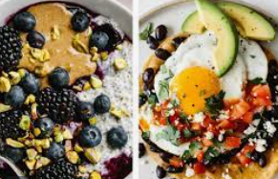
Y2 Maple Class Summer 2 Homework
Here are a few helpful ideas for the half termly homework project. These are only here as a suggestion, please feel free to get creative and do something that’s not already mentioned!
Geography- Farm to Fork!
Visit a farm and learn more about the different types of farming (take photos and post them on Class Dojo)
Create a poster about the different types of farming in the UK.
Research what farming is like in Egypt
Homework Ideas
DT- A Balanced Diet
Design your own healthy breakfast/lunch or wrap
Make a healthy snack and evaluate it after.

