Slide 1


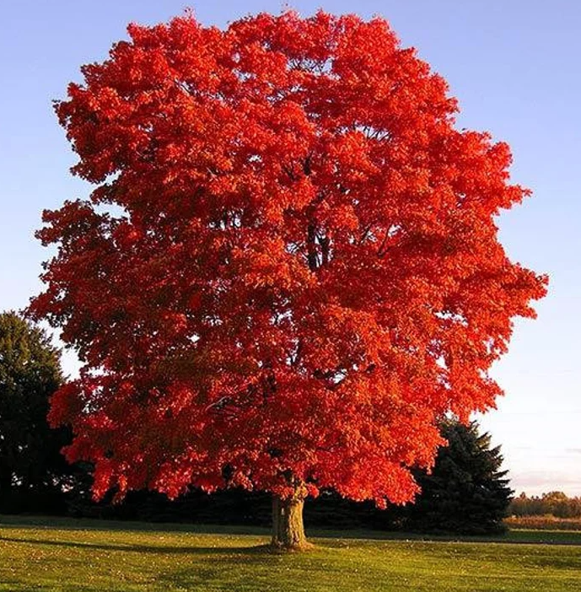
Y2 Maple Class Spring 2 Overview
Hello parents and carers, this half term your child will be learning about…
In our core subjects, we are learning about…
Subject | Focus
English | During our literacy lessons this half term we will be creating our own: Setting description ( about a fairground) Instructions(How to build a Ferris Wheel)
Maths | During our numeracy lessons this half term we will cover: Multiplication & Division Length and Height Mass, capacity & temperature
Science | Animals including humans (biology)
In our foundation subjects, we are learning about…
Subject | Focus
Geography | Brilliant Barnsley ( local area)
DT | Mechanisms – Fairground Wheel
PE | Target shooting (Tuesday) & Fitness (Friday)
Computing | Computer Science – Scratch Junior
RE | How can faith contribute to community cohesion? Focussing on Christianity and Judaism
Music | On this island! British songs and sounds– Kapow!
PSHE | Money and Work

Slide 2
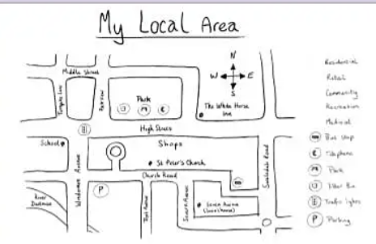
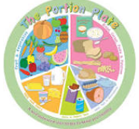
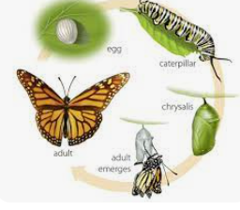
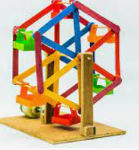

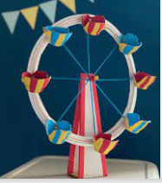
Y2 Maple Class Spring 2 Homework
Here are a few helpful ideas for the half termly homework project. These are only here as a suggestion, please feel free to get creative and do something that’s not already mentioned!
Geography- Brilliant Barnsley!
Complete a house survey within your local area (different house types)
Create a map of your local area.
Homework Ideas
Science
Life cycle of a human
(different life stages)
Life cycle of a butterfly
Make a healthy meal.
Design a healthy meal/plate.
DT
Make your own fairground structure.
Design a brand new Ferris wheel for a fairground

