Slide 1


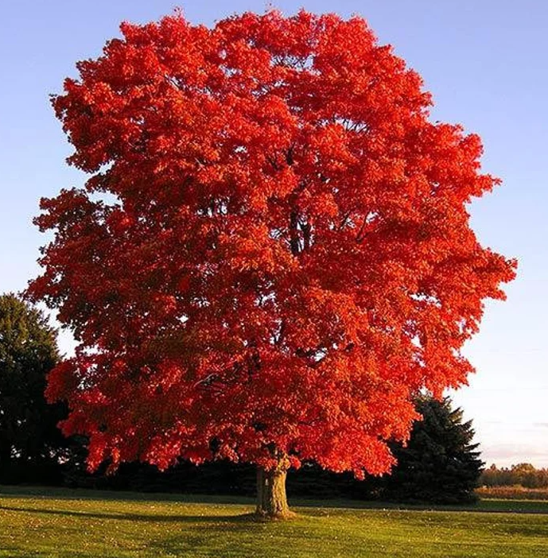
Y2 Maple Class Autumn 1 Overview
Hello parents and carers, this half term your child will be learning about…
In our core subjects, we are learning about…
Subject | Focus
English | During our literacy lessons this half term we will be creating our own: Character description Letter
Maths | During our numeracy lessons this half term we will cover: Place Value Addition & Subtraction
Science | Living Things
In our foundation subjects, we are learning about…
Subject | Focus
Geography | Continents & Oceans, Polar regions & The Equator
Art | Artist Focus – Brian Wildsmith Mediums used: drawing, painting & pastels
PE | Ball Skills & Fundamentals
Computing | E-Safety & Computer License (basic computer skills)
RE | Special Times: Christianity & Judiasm
Music | West African Call & Response Song

Slide 2

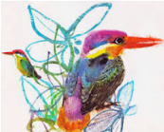
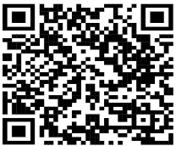
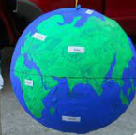
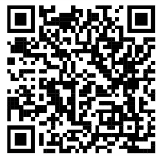
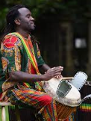
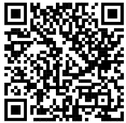

Y2 Maple Class Autumn 1 Homework
Here are a few helpful ideas for the half termly homework project. These are only here as a suggestion, please feel free to get creative and do something that’s not already mentioned!
Geography
*Poster about continents & oceans
*Make a DIY Globe
Art
*Recreate a Brian Wildsmith painting or design your own piece linked to animals and nature!
Scan the QR code to see how to make one!
Homework Ideas
Scan the QR code to watch a call and response tutorial
Science
Make a model of a food chain!
Watch this BBC video
all about food chains
first
Music
Write your own West African inspired call & response song and perform it!

