Slide 1


Welcome to Maple class

Slide 2

Maple Class
Hi, I’m Miss Leach!
I’ve been teaching for 9 years & it’s 7th year of teaching Year 2.
I trained to be a teacher at the same time as Mr Edwards, and actually went to university with him! I also completed my training year here at Lacewood with Mrs Burton as my mentor!
Y2 is very different for the children they have a lot to cover and learn.
The classroom is a little more structured compared to Y1 and the children will need a bit of time to get settled in and used to this new way of learning.
I understand that children might be apprehensive or nervous so my first job is to help your child feel safe and happy and to build their self confidence.
We like to have fun in Maple and we have some super exciting topics this year.
We will also have 4 amazing teaching assistants.

Slide 3
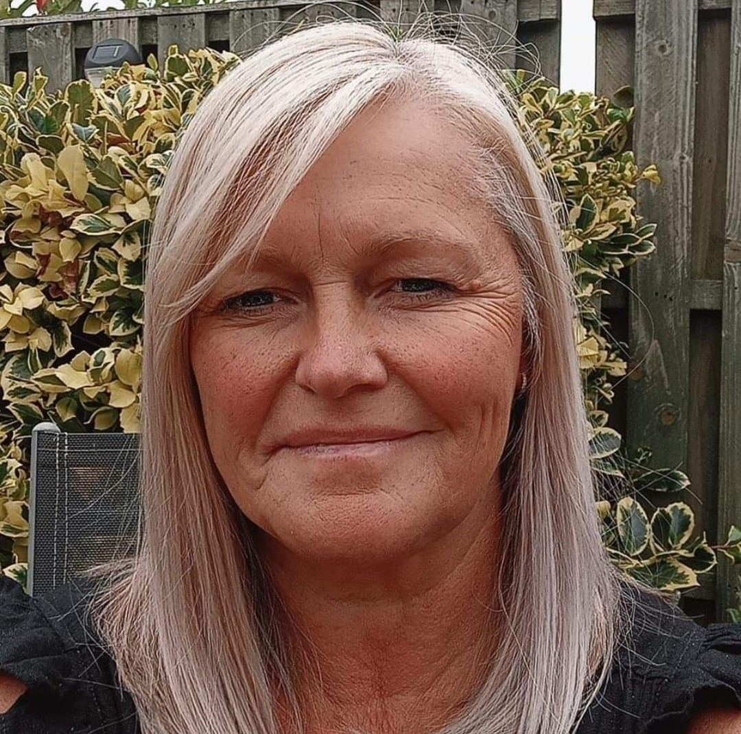
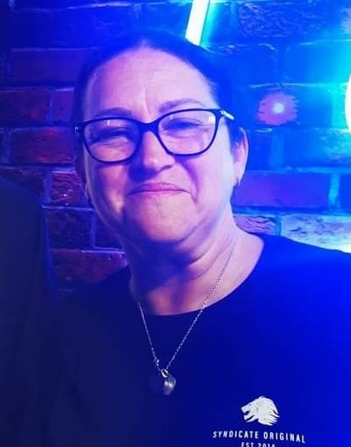
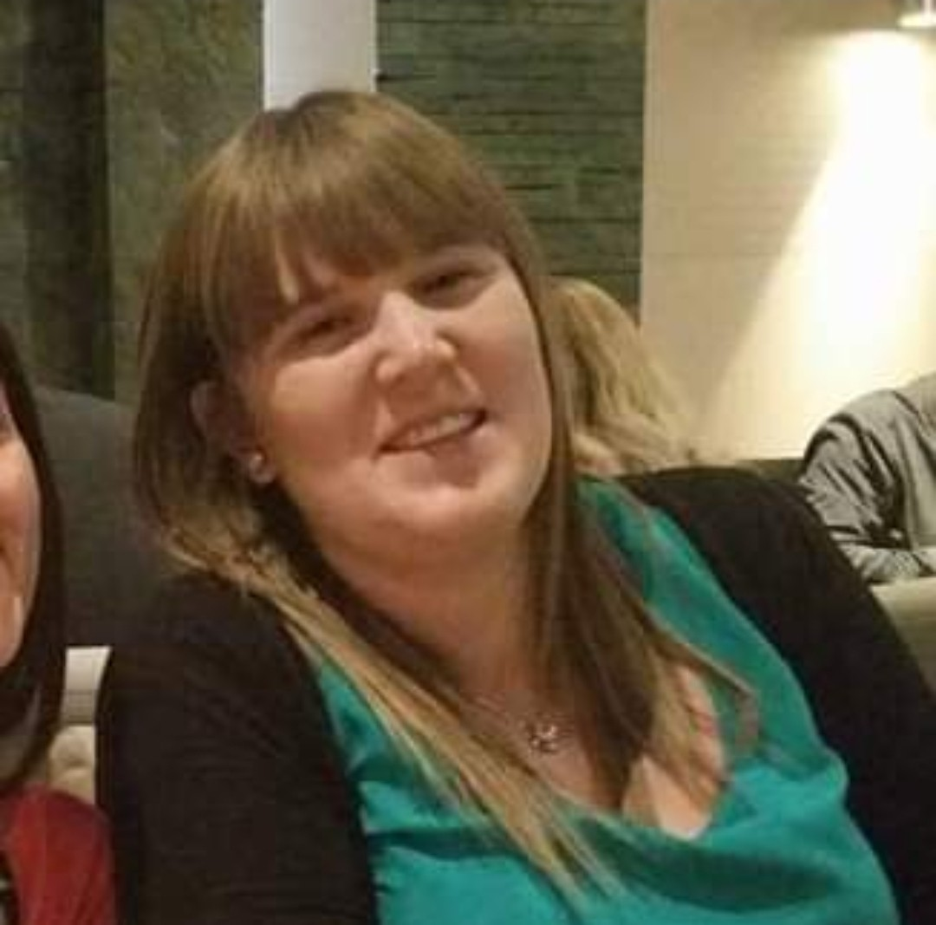
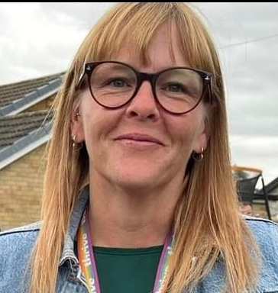
AM
Miss Hole & Mrs Greaves
PM
Mrs Gasgcoine & Mrs Goose

Slide 4

Start and finish times in September
Maple Class will:
start at 8.35 am
finish at 3.15pm.
It is absolutely crucial to your child’s development and progress that they arrive at school on time due to the things we cover in those 25 minutes before lesson start. Vital coverage of spelling rules happen during this time and quite often we have revision of maths skills too!

Slide 5

Golden Rules
We take care of ourselves.
We take care of each other.
We take care of things around us.
And we ALL ‘Try our best to be our best!’

Slide 6
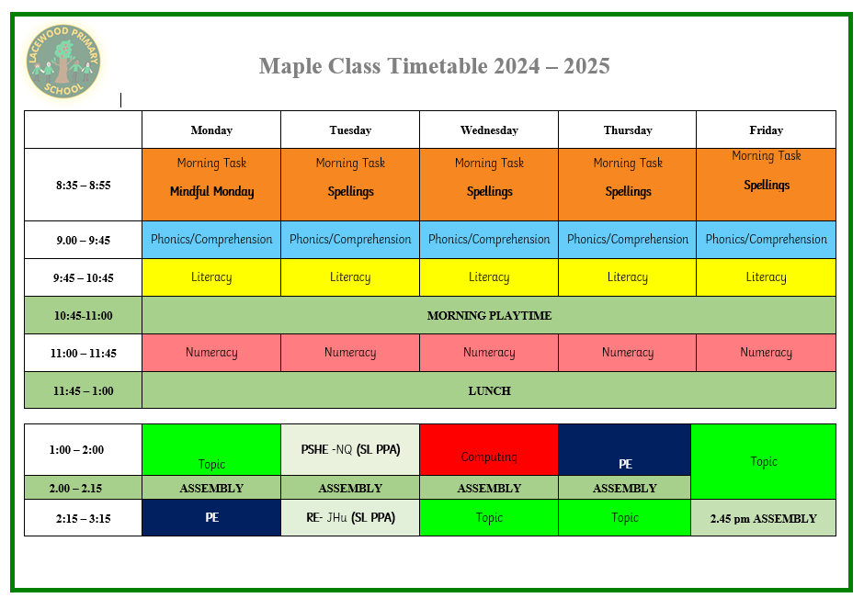

Slide 7
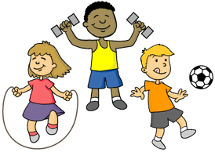
PE
PE will take place on:
Monday afternoon
Thursday afternoon
Your child will need the following kit:
Black shorts.
School PE top (green is being phased in)
Bare feet in the hall.
Trainers & track suit bottoms/shorts
No earrings
Please ensure your child has the correct kit as they won’t be allowed to participate in the lesson if not and a phone call home regarding this will be made.

Slide 8

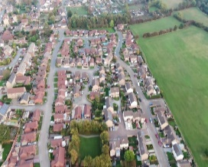
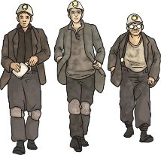
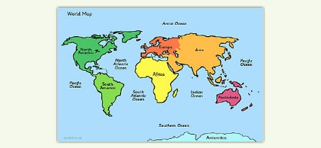
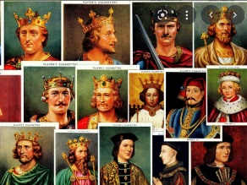
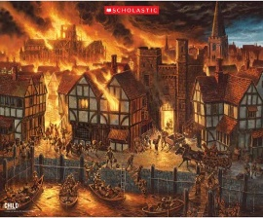
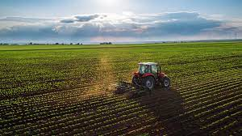
This year’s topics.
Autumn Spring Summer
1
2
1
2
1
2

Slide 9
This half term….
Subject | Focus
Geography | Exciting Earth! -Continents & Oceans
Science | Living Things
Art | Artist- Brian Wildsmith -The Art of Painting
RE | Special Times ( Christianity & Judaism)
Computing | Digital Literacy- What is IT?
PE | Ball Skills ( Tuesday) & Fundamentals ( Friday)
Music | West African Call & Response Song
PSHE | Families Friends and people who care for me!

Slide 10



Slide 11
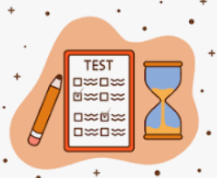
Children will still be assessed termly, just like in every other year group and their final summer term assessment will determine whether they achieve :
Working towards
Expected
Greater Depth

Slide 12

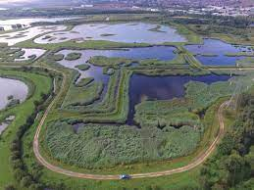
Trips
Hopefully, our trip will be to RSPB in the Autumn term – November time
This will link with our science topic all about living things and their habitats.

Slide 13
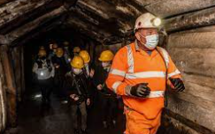
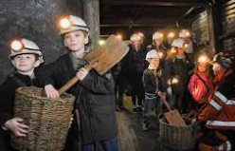
Trips
Our trip will be to the coal mining museum in the summer term.
This will link with our history learning all about mining!

Slide 14

Home work
Children will receive weekly homework on Friday
(due in the following Friday)
spellings ( test on Friday)
maths activity ( which will link with that particular week’s learning)
Children who receive:
4 or more out of 5 ( if they are in spelling group 2)
or 8 or more out of 10 ( if they are in spelling group 1)
will receive a dojo point
Children who also bring their maths homework in on time will also receive a dojo point for their effort ☺

Slide 15
Home work
There will also be homework at the start of each topic where
children can choose from a given set of tasks to do.
Your child will receive a reading book and
a home school reading log for you to document when they read at home.
We would love it if you could read as much as possible with them at home which will support their learning in school. ☺

Slide 16
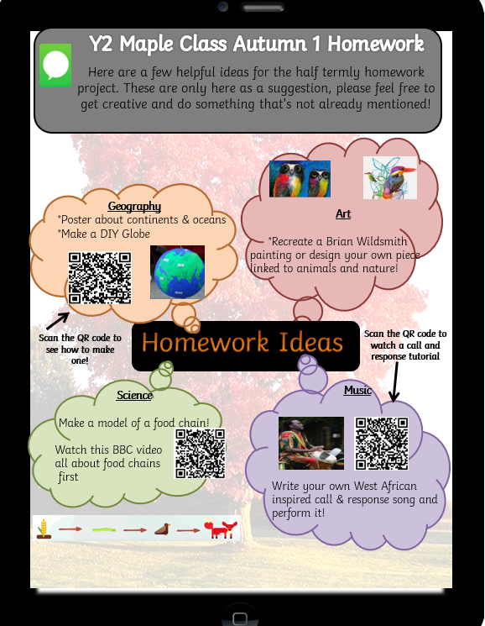
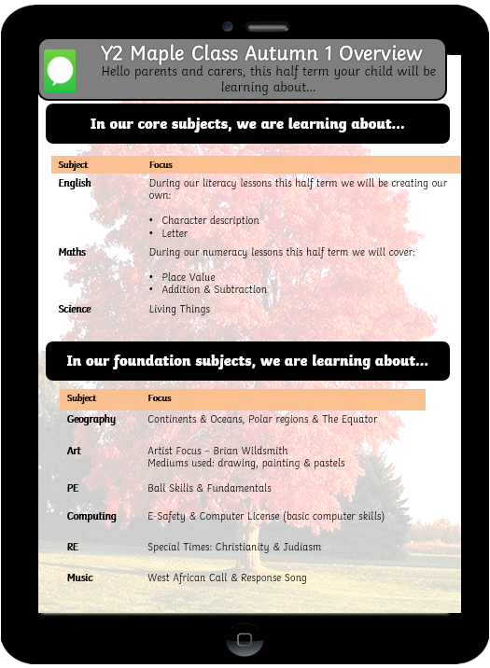
Half Termly Homework Sheet

Slide 17

New reward system in school, you will be notified on the app when your child receives a positive or negative behaviour point
Class Dojo
A letter was sent out on Wednesday detailing this.
This will ultimately replace FB as our mode of communicating with parents. There is a messaging option so you will always be able to contact us.
There is also a thread page where I can post reminders etc.
There is also the option for your child to take photos of their work and upload them to their

Slide 18




Weekly Merits
Merit assembly & Golden Award will be at 2.45pm on Fridays

Slide 19

Contact Me
Contact me on the Facebook page (until the end of this half term) Class Dojo app or at end of the day at the door.

Slide 20

Any Questions?
Send me a message on the face book page or by phoning the office.
We ask that anything of a serious nature is not be sent on FB instead we ask that you ring the office so it gets dealt with immediately and passed straight on.

